Slide 1

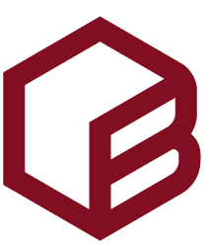


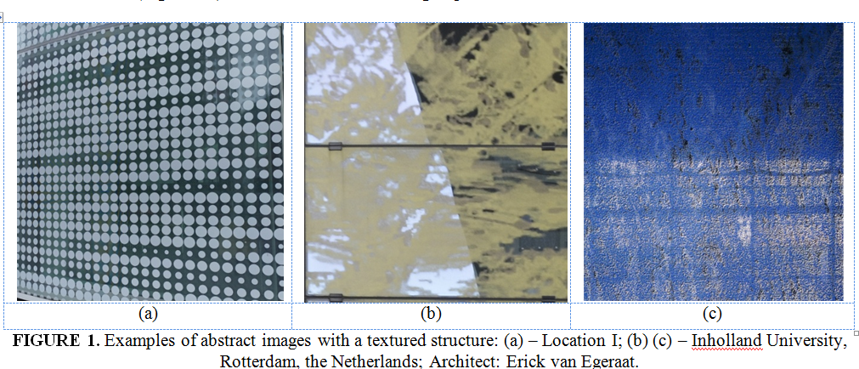
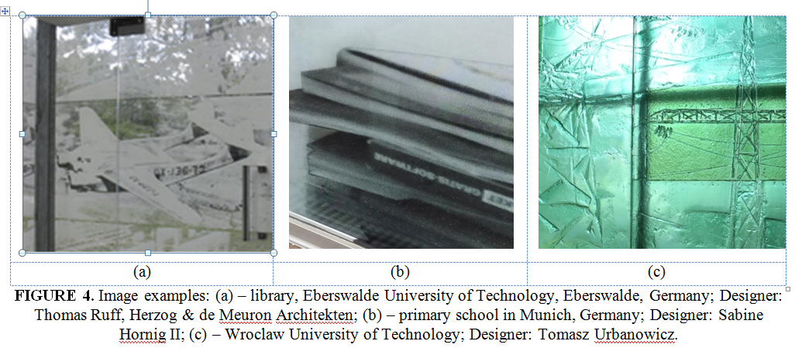
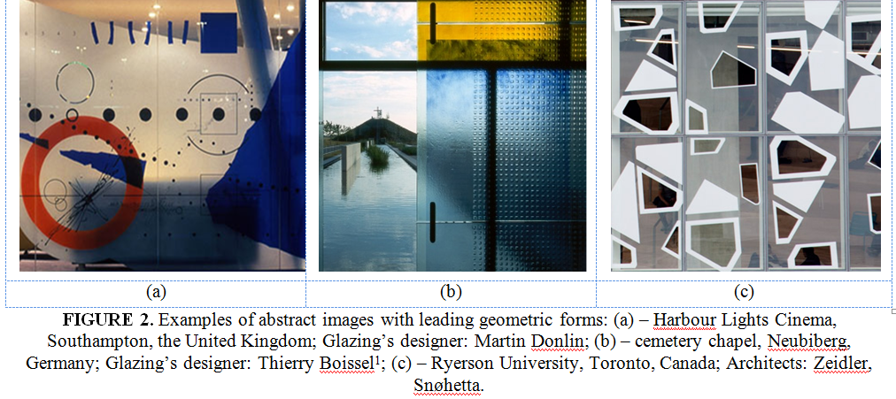
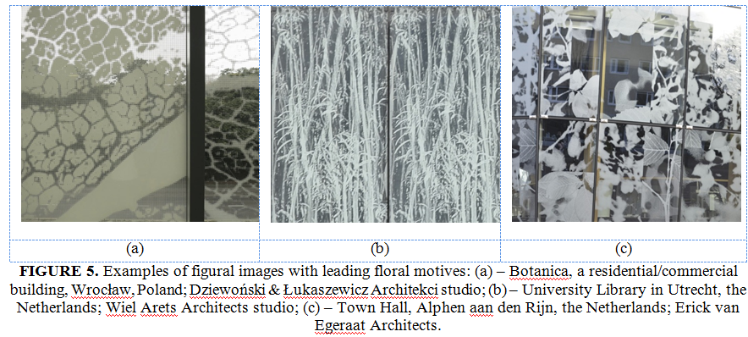
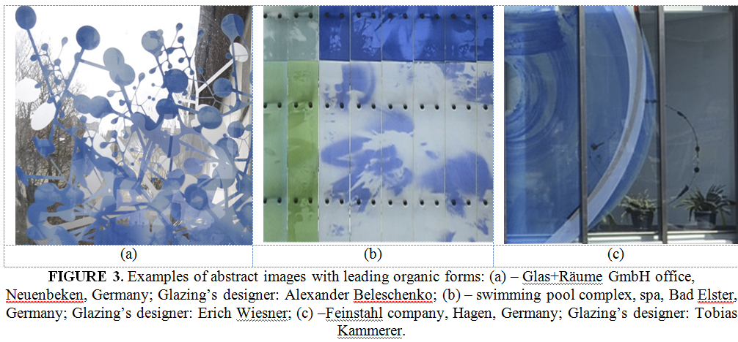
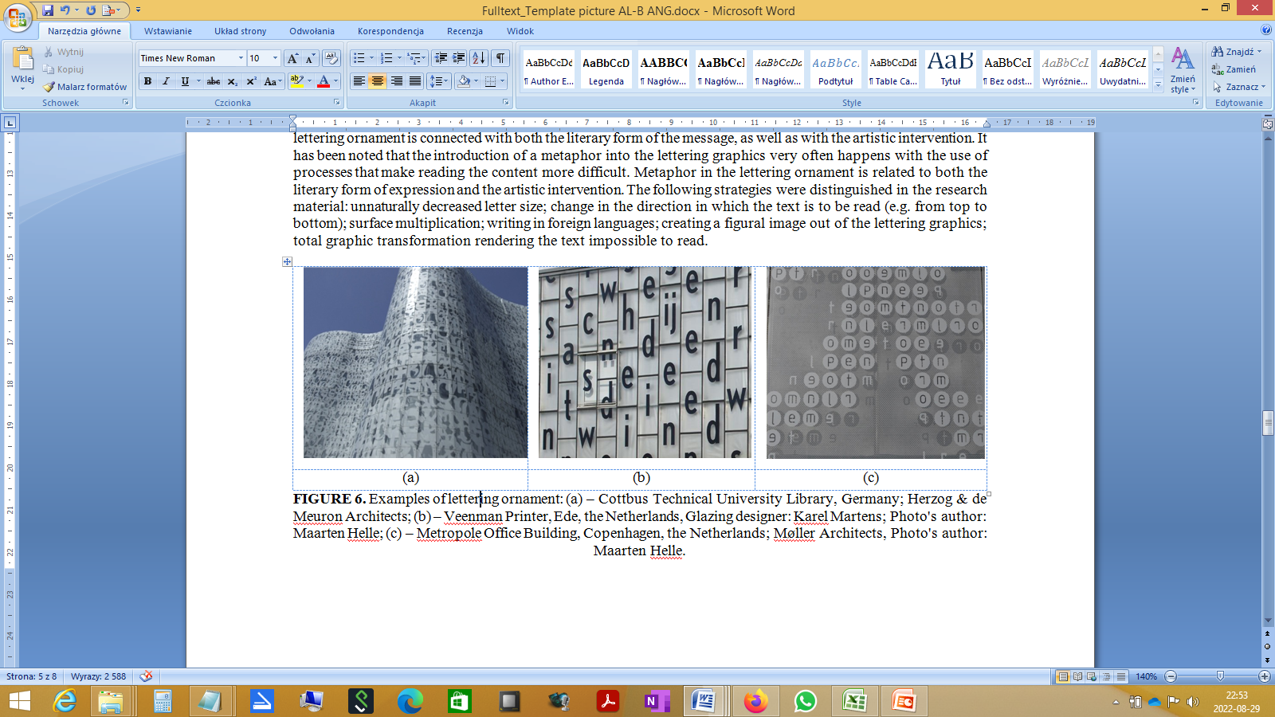

GRAPHICS ON GLASS - DESIGN AND APPLIED FORMAL TREATMENTS
Alina Lipowicz-Budzyńska, PhD, Eng. Of Architecture
Al. prof. S. Kaliskiego 7, 85-796 Bydgoszcz, Poland
b
Introduction
An image placed in a glass façade of a building significantly affects the reception of both its interior as well as the outside. The way in which that image is seen and its influence are connected with the applied compositional and artistic values. A lot depends on the used means of artistic expression: colour, form, composition, image scale. The objective of this article is to determine trends in images on glass. The research covered 55 glass façades. Images on glass were analysed in terms of their structure as well quality and artistic treatment applied to the graphics on glass. The collected research material in the form of art glass projects constitutes the basis for the analysis of the applied artistic qualities of the image.
The collected art glass projects, which were used as the research material, had been completed either at the turn of the 20th and 21st centuries or in early 21st century. Due to the global nature of artistic phenomena, which also affect art glass, no limit was placed on the territory of the analysis.
(b)
Material and Methods
The research material was divided into the following image groups: abstract images with textured structure; abstract images with leading geometric shapes; abstract images with leading organic components; figural images; figural images with leading floral motifs; images mainly composed of a lettering ornament; images in which the dominant aesthetics is hard to discern. The collected research material, in the form of 55 buildings in which art glass has been used, was analysed in terms of the artistic/aesthetic structure of the image. An analysis of the artistic qualities combined with the image’s aesthetic values led to the emergence of the seven groups: abstract images with textured structure (20%); abstract images with leading geometric shapes (20%); abstract images with leading organic components (10.9%); figural images (12.7%); figural images with leading floral motifs (14.55%); images mainly composed of a lettering ornament (14.55%); images in which the dominant aesthetics is hard to discern (7%).
Discussions & Conclusions
Four common traits connected with compositional processes of the image presented on glass were found in the research material.
Three types of image multiplication were distinguished: linear, surface, and structural multiplication. Linear multiplication occurs when a single artistic element or an arrangement of elements is multiplied horizontally or vertically along a line. A linearly multiplied image creates a plane with distinct strips of the multiplied artistic motif. This is how an ornament is made on glass, which may function in a space as an architectural detail.
Surface multiplication proved to be the most frequently used image multiplication technique; it was present in more than half of selected glazing projects. A motif or an arrangement of motifs was multiplied, in either an ordered or chaotic way, creating a uniform texture. An image created as a result of surface multiplication is uniformly covered with the multiplied elements without distinguished multiplication lines. The rest of the material is structural multiplication. It is a multiplication of an artistic motif or an arrangement of motifs occurring in a certain order, usually along curves, which then leads to the creation of a structure that constitutes a pattern. Another process used in glazing projects is image scale manipulation. These are mostly figural images connected with the building’s purpose or the history of the place. Many of them have a symbolic meaning. The change of image scale occurs in textured images, in which, through multiplication and scaling of selected motifs, texture surfaces are created on glass. This is used both in abstract as well as figural images. Scaling plays an important part in projects in which the main pattern are enlarged single images. A rescaled image takes on a new artistic identity, bringing a new value to the composition..
Acknowledgements
This material has been supported by the Polish National Agency for Academic Exchange under Grant No. PPI/APM/2019/1/00003

