Slide 1
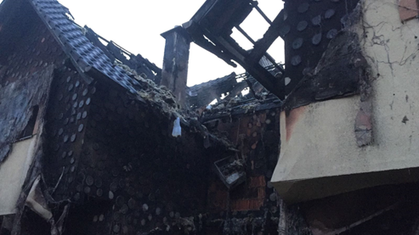
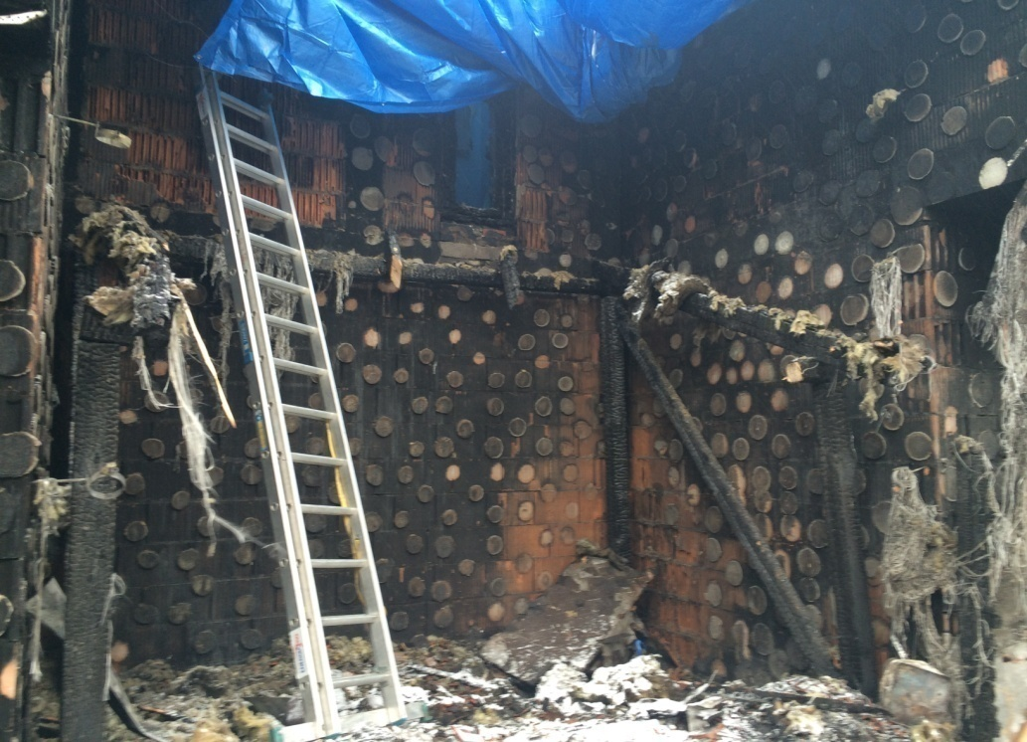
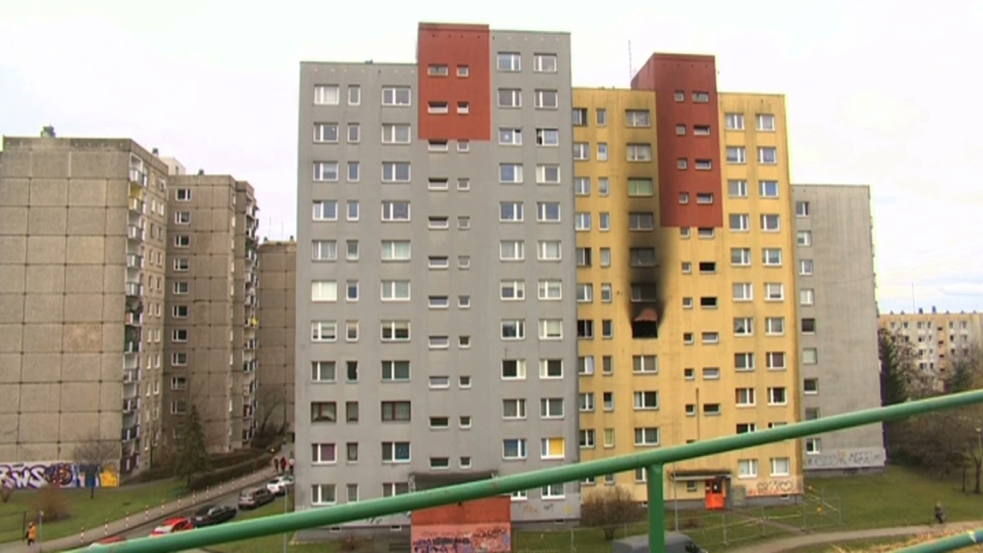
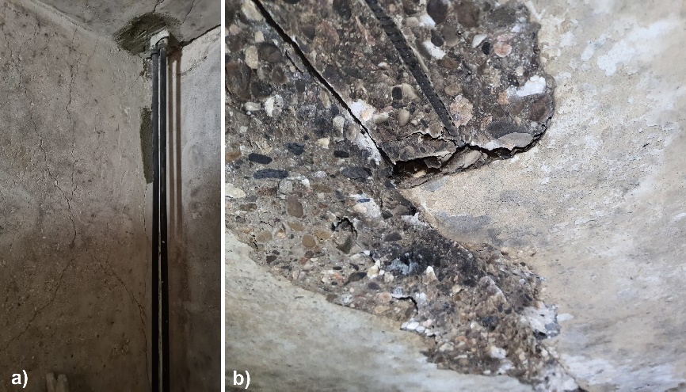
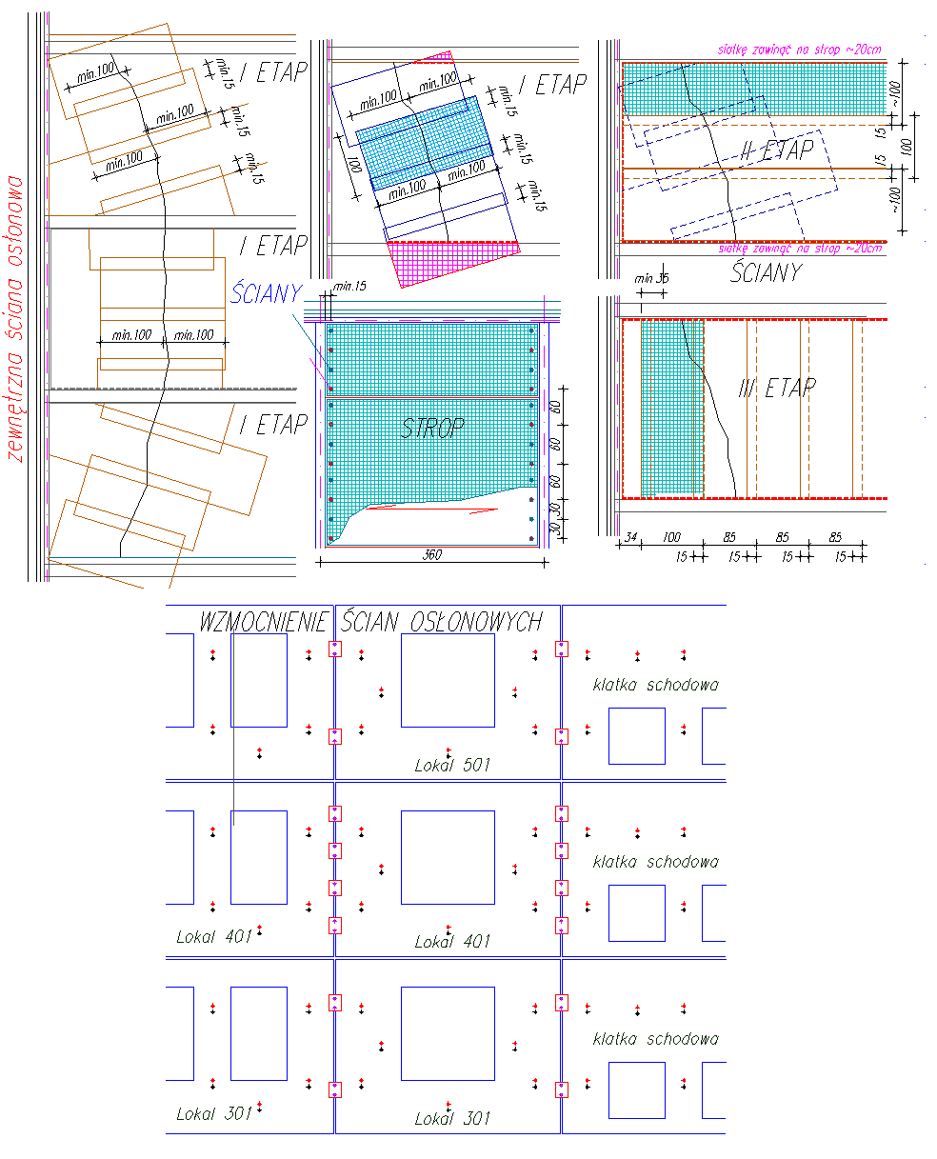
LOGO / Name
of
Univ./Institute
Strengthening Building Structures Subject to Fire Conditions on the Example of Selected Cases
Dariusz Bajno, Dawid Grucki, Marcin Fiutak , Agnieszka Grzybowska , Natalia Budnik
Introduction
Fire safety is not clearly defined in literature and legal regulations. The growing spectrum of contemporary threats in this field is the subject of many works and scientific studies, which allow for the analysis of directions and solutions for optimization and improvements in the field of fire protection. The currently used construction and material solutions as well as fire safety engineering technologies allow for effective organization of fire protection in buildings and structures, leading to ensuring the safety of people, facilities and property [10]. Construction and material solutions in the construction process often have economic limitations that affect the optimization of fire safety in buildings.
EXAMPLE OF A RETAIL BUILDING DAMAGED BY FIRE
The first to be presented is a fire event that damaged one of the single-family terraced houses in southern Poland during the night hours, i.e. around 2-3AM on 4th to 5th December 2016. An economic and garden facility with a wooden structure covered with bituminous shingles caused the fire to spread to the polystyrene thermal insulation layer in adjacent buildings, which resulted in the fire being transferred to the residential building. As a consequence, the fire spread to the soffit and the entire roof of the apartment building, but did not reach its interior. It was stopped at the ceiling level above the first floor as a result of the action of the fire brigade.
When proceeding to determine the technical condition of buildings affected by a fire event and their elements, individual elements of the building were inspected. The research was carried out by random method based on macroscopic inspection. The roof and roof structure of the building along with the insulation in the segment was completely destroyed by fire. A significant part of the roofing was damaged (during a fire and extinguishing action) by burning the beams of the main structure (in some tested beams it was approx. 0.5 cm).
EXAMPLE OF A HIGH BUILDING DAMAGED BY FIRE
The fire incident took place in a housing estate in south-west Poland, on December 30, 2021. The fire affected a flat on the 4th floor of the building (high-rise building- figure). The apartment was completely covered with fire, and the evacuation action covered the entire building. According to [11], the tall structure was regularly subjected to periodic technical inspections and had a properly kept building book, in accordance with [12, 13, 26]. On December 30, 2021, a fire occurred on the fifth floor of the building, which lasted over 1.5 hours, threatening the safety of the entire facility. It would not be so dangerous if it were a building made in traditional technology, e.g. brick.
To increase the adhesion of the PBO nets to the substrate (walls and ceilings), additional one or two-sided connectors were introduced in the form of ready-made joints or in the form of bundles made of the same material. The last stage of reinforcements was to protect the newly constructed structures against fire and high temperature. They were made by applying on composite layers of cement-lime plasters, while the steel structures were protected with a fireproof casing and covered with intumescent coatings, thus bringing the elements to the REI60 fire resistance class .
As part of the local reinforcements, a steel structure was introduced as a supplement to the load-bearing capacity of the rims lost as a result of the fire, at the connection points of prefabricated elements and the damaged entrance frame to the premises of the 4th floor.
Discussions & Conclusions
Random events are difficult to predict during the operation of buildings. Nevertheless, the response to them should be relatively quick and effective, although there are no universal methods of strengthening and repairing structures, especially those at risk of a construction disaster.
The proposed remedial strengthening solutions should neither change the static structure of the structure nor make it stiff. According to the authors of the article and work [26], the suggestions for remedial measures should include the use of materials and technologies that are close to the original solutions. Despite the fact that the assumed service life for some of the buildings constructed in the "large panel" technology has already expired or is close, this technology is still considered safe, but requires constant and reliable periodic inspections. Its "weak points" are still layered curtain walls and vertical joints of prefabricated elements, to which there is no direct access. In the described case, it was considered probable damage to the suspension wall elements on the transverse wall structures as well as the probability of damage to the vertical joints of prefabricated elements and rims, which was taken into account in the proposed and implemented repair methods, supported by appropriate calculations.
Acknowledgements
This article/material has been supported by the Polish National Agency for Academic Exchange under Grant No. PPI/APM/2019/1/00003.

