Slide 1

Health-promoting places.
Rain gardens and sustainable water management. dr inż. arch. Monika Trojanowska
Faculty of Civil and Environmental Engineering and Architecture
UTP University of Science and Technology in Bydgoszcz, Poland

Slide 2
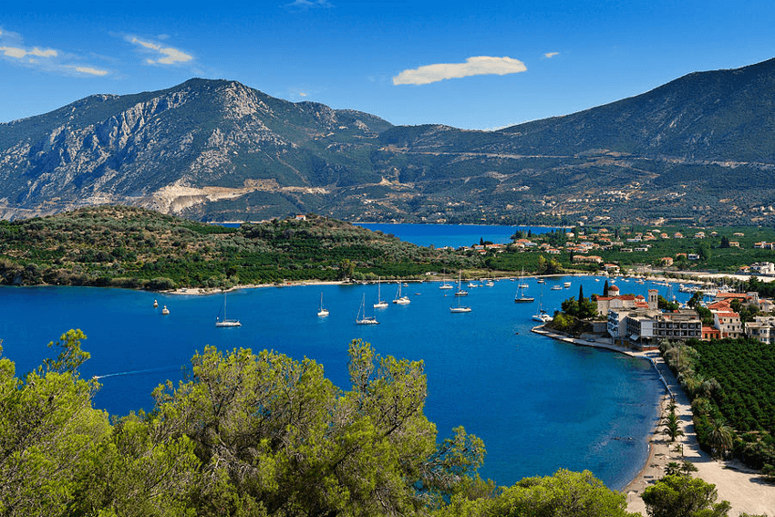
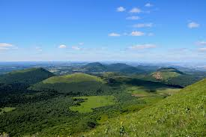
Therapeutic landscapes and health-promoting places

Slide 3
Qualities of health-promoting places
presence of greenery
presence of water

Slide 4

Presence of water in the sustainable urban drainage systems.
IWA - International Water Association
17 Principles for water-wise cities grouped into four categories:
Regenerative Water Services
Water Sensitive Urban Design
Basin Connected Cities
Water-Wise Communities
Source: https://iwa-network.org/projects/water-wise-cities/

Slide 5
Presence of water in the sustainable urban drainage systems.
Level regenerative water systems include principle to
  replenish waterbodies and their ecosystems.
Level water sensitive urban design encourages to
  enhance liveability with visible water.
Level basin connected cities calls for
  plan to secure water resources and mitigate drought.
Level water-wise communities encourages
  empowering citizens.
Source: https://iwa-network.org/projects/water-wise-cities/

Slide 6
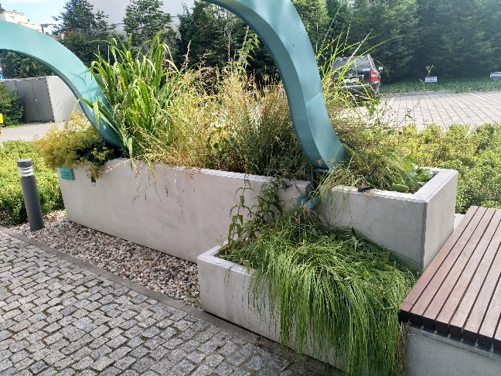
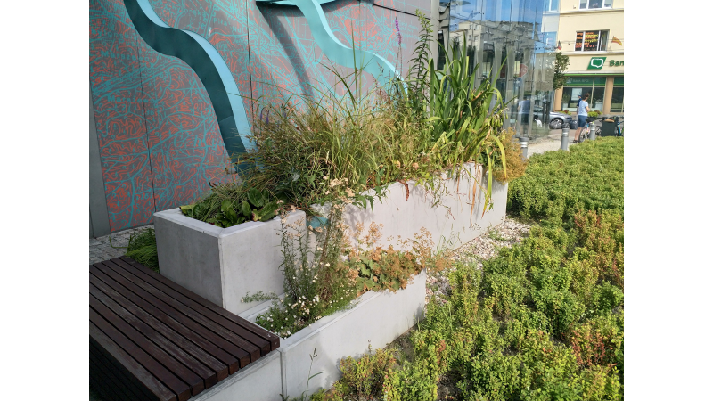
Rain garden, Gdynia Infobox, Poland

Slide 7
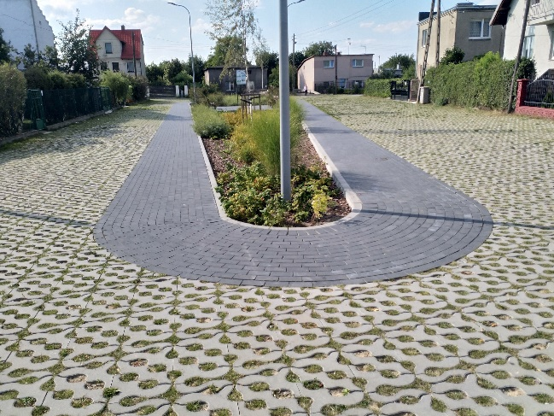
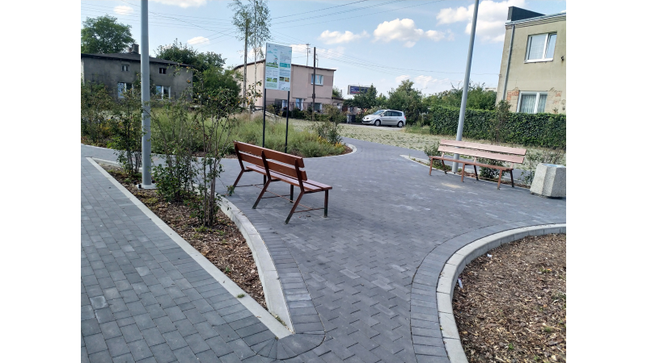
Rain garden, Gdynia – Chylonia, Poland

Slide 8
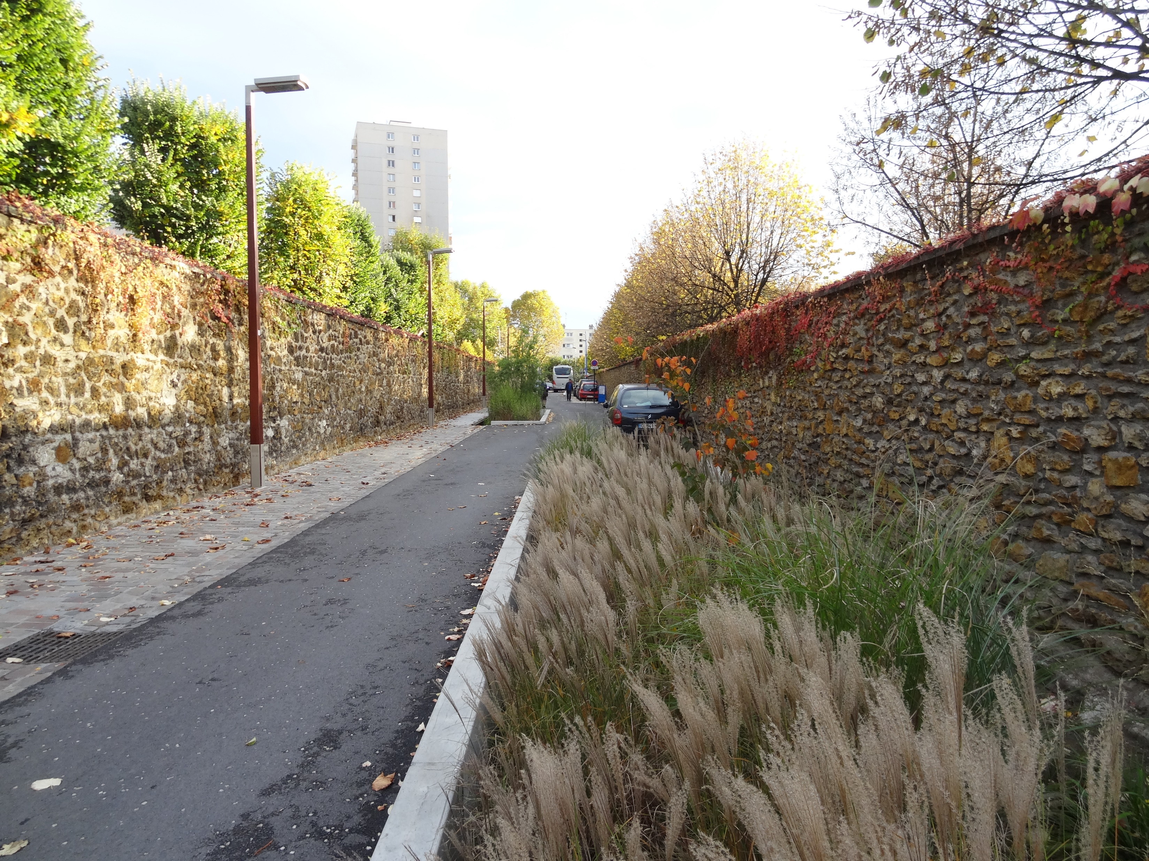
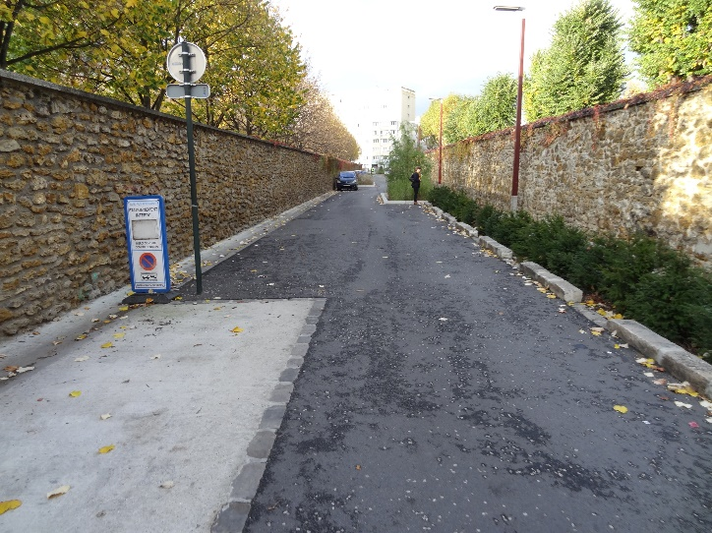
Rain gardens, Rue Sœur Valérie, Asnièrs sur Seine,France

Slide 9
THANK YOU FOR YOUR ATTENTION!
This article/material has been supported by the Polish National Agency for Academic Exchange under Grant
No. PPI/APM/2019/1/00003
The project is financed by the Polish National Agency for Academic Exchange

