Slide 1

Health-promoting places.
Architectural variety. dr inż. arch. Monika Trojanowska
Faculty of Civil and Environmental Engineering and Architecture
UTP University of Science and Technology in Bydgoszcz, Poland

Slide 2
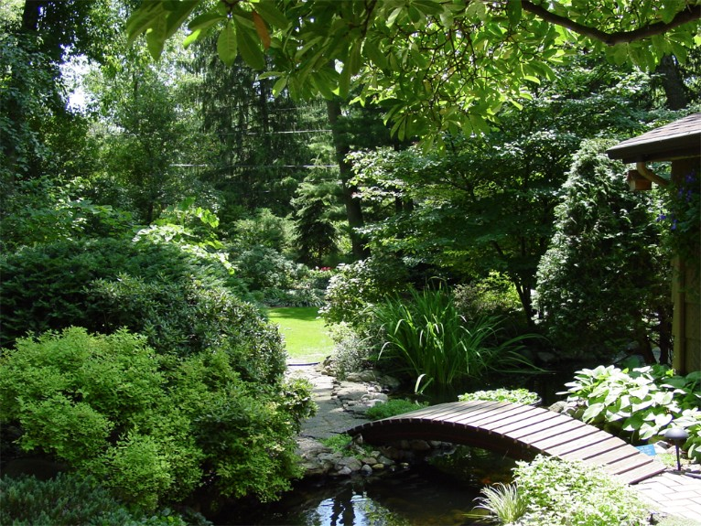
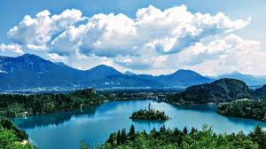
Landscapes that stimulate the process of healing.

Slide 3
Features of urban environment that promote healing and well-being and relate to complexity and order.
Contact with nature
Physical beauty of the environment
Optimal level of complexity
Legibility

Slide 4
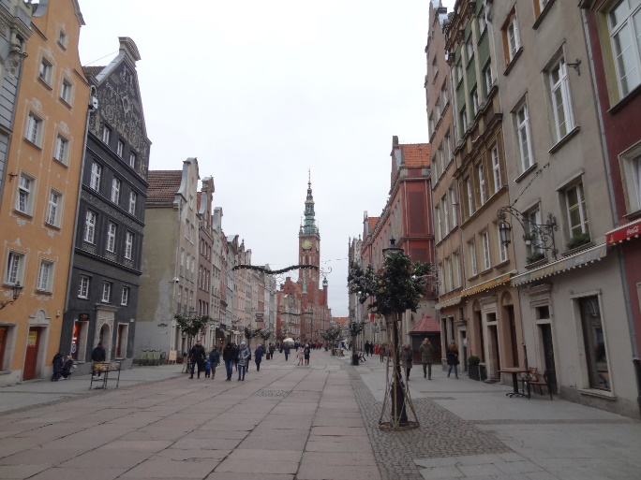
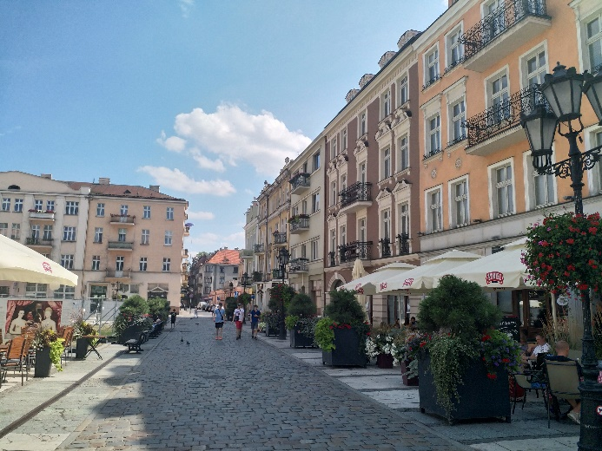
Traditional cityscape demonstrates architectural variety of urban environment
Gdańsk, poland
Kalisz, poland

Slide 5
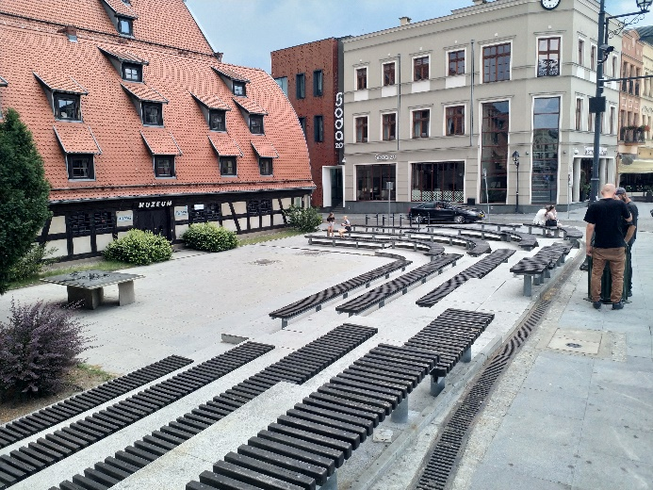
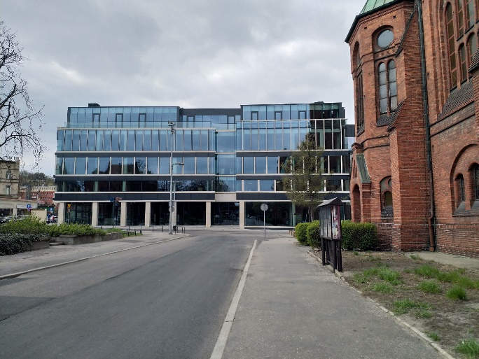
New architecture and old monuments
bydgoszcz, poland
bydgoszcz, poland

Slide 6
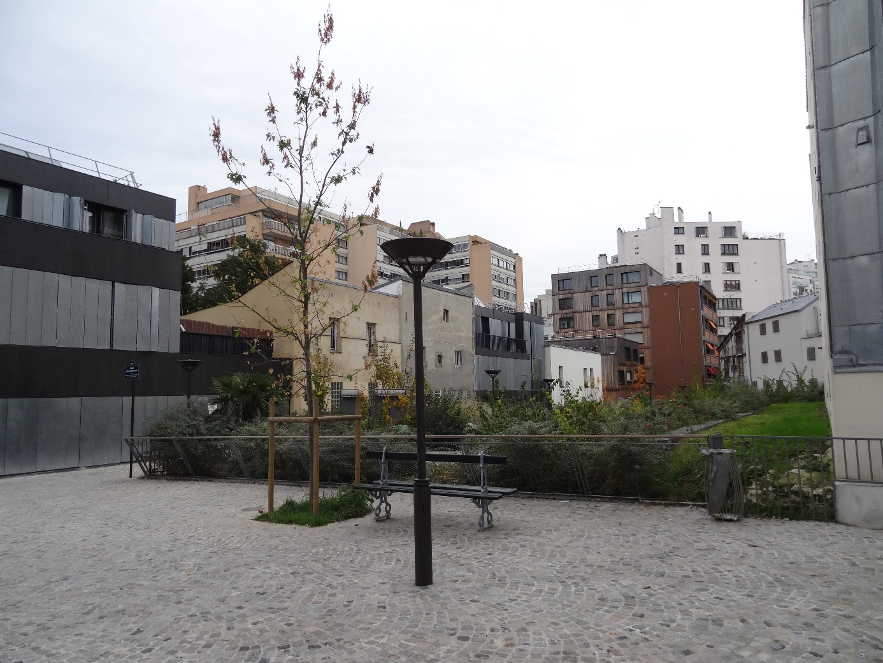
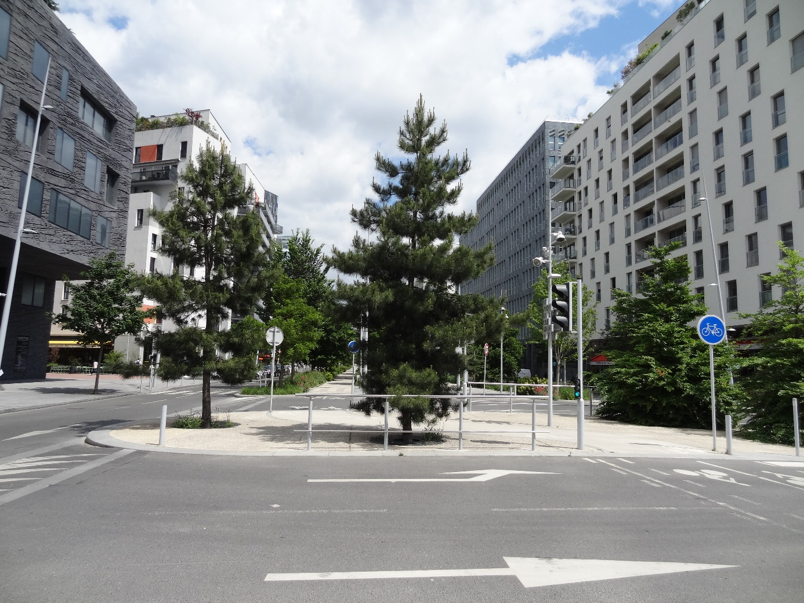
New eco-neighbourhoods
ZAC Frequel-Fontarabe, Paris, france
ZAC trapèze, Boulogne-Billancourt, France

Slide 7
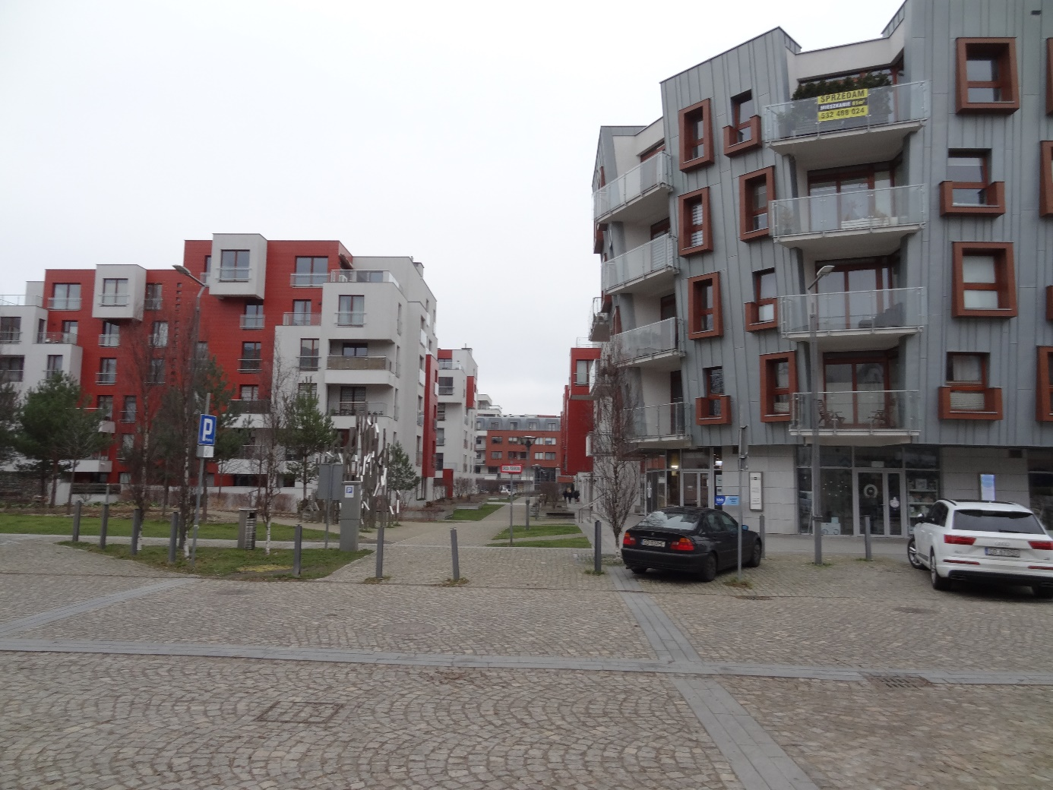
Architectural variety
Garnizon, Gdańsk, Poland

Slide 8
THANK YOU FOR YOUR ATTENTION!
This article/material has been supported by the Polish National Agency for Academic Exchange under Grant
No. PPI/APM/2019/1/00003
The project is financed by the Polish National Agency for Academic Exchange

